Slide 1
DuPont Water Solutions #TheButterflyEffect

Slide 2
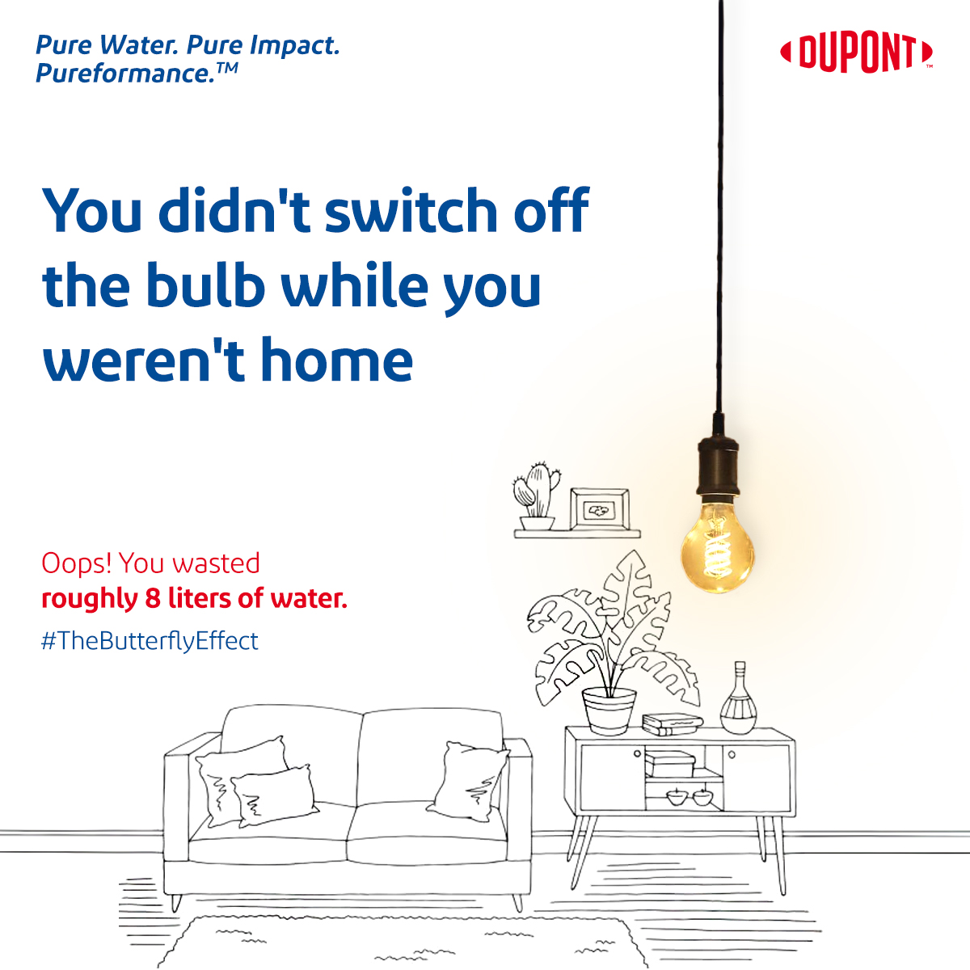
Post 1
Content Bucket: DuPont (Static)
Some actions cause more colossal effects than you think!
If you leave a light bulb on for no reason, it will have no influence on your electricity bill electricity, it has another side to it too! On average, the power necessary to light a bulb for one hour takes 5-6 litres of water. Just imagine how many litres of water you have wasted till now, due to carelessness.
Let's take small steps towards water conservation and it will create a bigger impact in the longer run.
.
.
#DuPont #WaterTechnologies #DuPontWaterSolutions #DuPontWaterSolutionsIndia #TheButterflyEffect #WaterConservation

Slide 3
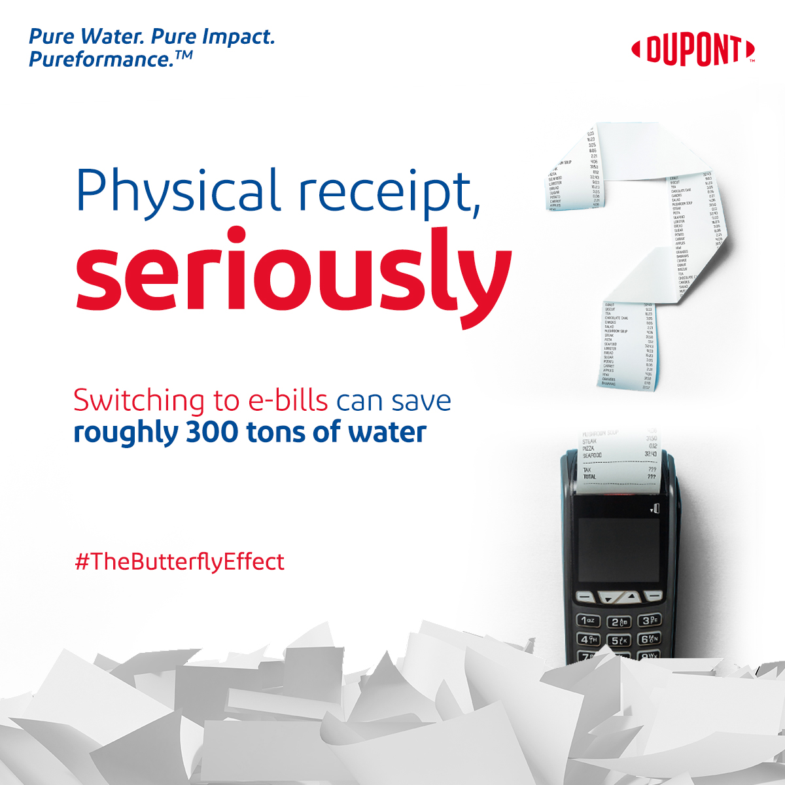
Post 2
Content Bucket: DuPont (Static)
Some actions cause more colossal effects than you think!
Every time you ask for a receipt that you will throw anyways, just think about the amount of water that you wasting.
A study has shown that if we completely switch to digitally generated bills and invoices, about 300 tons of water could be saved globally. Stop asking for physically generated paper bills and start reducing your water footprint.
Let's take small steps towards water conservation and it will create a bigger impact in the longer run.
.
.
.
.
#DuPont #WaterTechnologies #DuPontWaterSolutions #DuPontWaterSolutionsIndia #TheButterflyEffect #WaterConservation

Slide 4
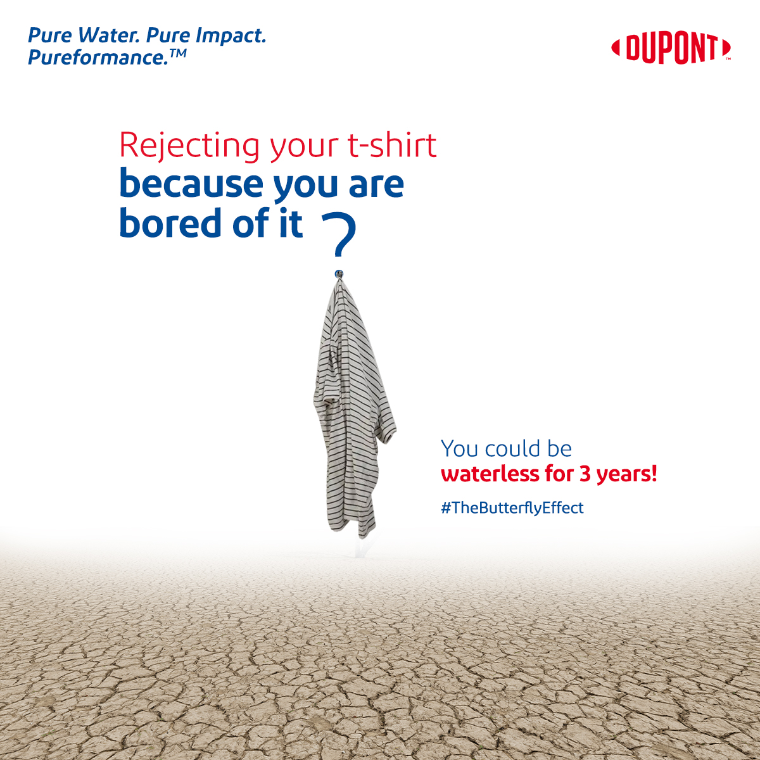
Post 3
Content Bucket: DuPont (Static)
Some actions cause more colossal effects than you think!
Your t-shirt label will only show cotton as its key material but won't mention the amount of water used. According to the reports published by WWF, a t-shirt soaks up to 2700 litres in manufacturing. This is the amount of water that you will consume roughly in 3 years.
Don't let your fashion statement be a reason for waterless earth.
Let's take small steps towards water conservation and it will create a bigger impact in the longer run. .
.
.
.
#DuPont #WaterTechnologies #DuPontWaterSolutions #DuPontWaterSolutionsIndia #TheButterflyEffect #WaterConservation

Slide 5
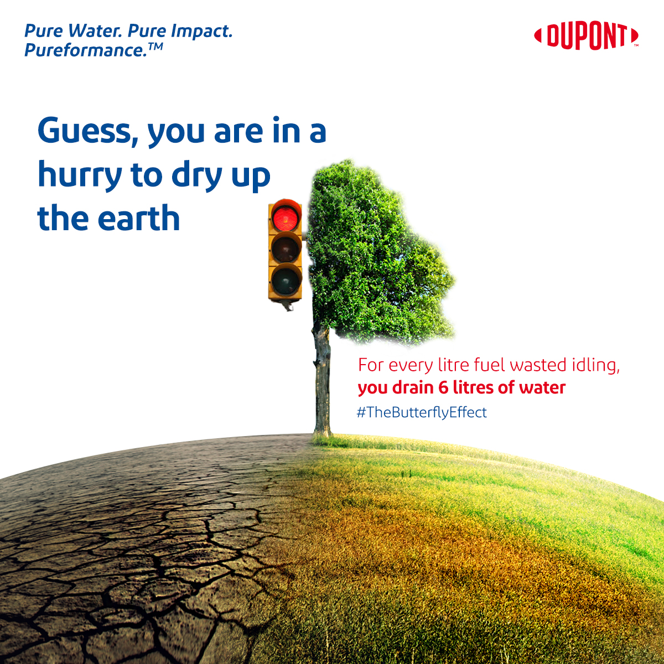
Post 4
Content Bucket: DuPont (Video)
Some actions cause more colossal effects than you think!
It seems impossible to waste water without doing anything, but you do. While you wait for the traffic light to turn green, the engine of your vehicle is drying up water much faster than it's drying up petrol in your tank! On average, a person burns roughly 1 litre of petrol idling, it takes 6 litres of water to process that 1 litre of petrol in the refinery. Let your engine rest for a while as you wait in the traffic.
Let's take small steps towards water conservation and it will create a bigger impact in the longer run. .
.
.
.
.
.
#DuPont #WaterTechnologies #DuPontWaterSolutions #DuPontWaterSolutionsIndia #TheButterflyEffect #WaterConservation

Slide 6
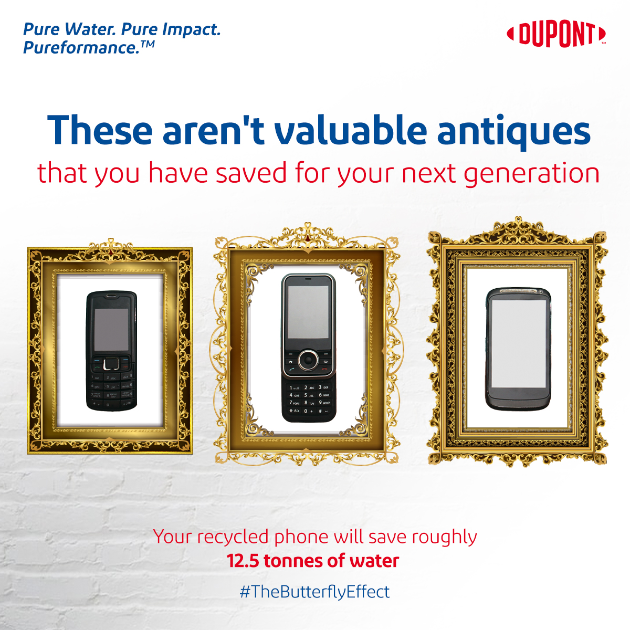
Post 5
Content Bucket: DuPont (Static)
Some actions cause more colossal effects than you think!
As boasting off the features of the latest version of your favourite smartphone, the older smartphone finds its place in your drawer along with other cell phones. Reports suggest that it takes 13 tonnes of water to build a new smartphone from scratch and you can easily reduce this consumption by recycling the older phone. Around 90% of parts from the older phones can be used to make a new phone, you will be saving 90% of water in that process. So recycling your old phones so that you have enough water to drink and enjoy the latest tech.
Let's take small steps towards water conservation and it will create a bigger impact in the longer run.
.
.
.
#DuPont #WaterTechnologies #DuPontWaterSolutions #DuPontWaterSolutionsIndia #TheButterflyEffect #WaterConservation

Slide 7
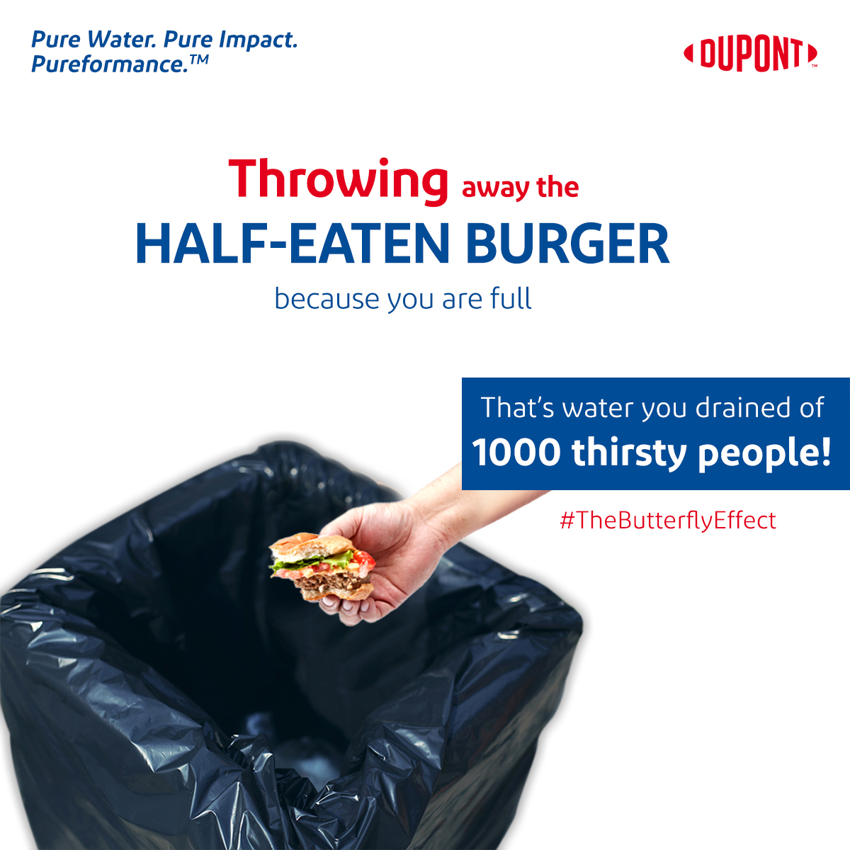
Post 5
Content Bucket: DuPont (Static)
Some actions cause more colossal effects than you think!
For you, it's just a regular burger but the amount of water required to make it can quench the thirst of 1000 people for one day. The total water required by each component of a fully-loaded burger sums up to 3000 litres which you wouldn't realize as its passive water requirement. Next time, just order only what you can finish, not what you want!
Let's take small steps towards water conservation and it will create a bigger impact in the longer run.
.
.
.
#DuPont #WaterTechnologies #DuPontWaterSolutions #DuPontWaterSolutionsIndia #TheButterflyEffect #WaterConservation

